Slide 1
Hobby Web App (SMS)
Moheen Akhtar

Slide 2
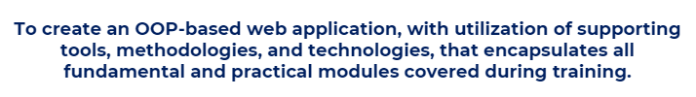
Intro
Main objective
Application connected with front-end website and back-end API

Slide 3
My approach
SMART goals
Specific
Measurable
Achievable
Realistic
Timely
List all plans (To do List)
Rank- Which tasks are the most important. Repercussions?
Adaptability and flexibility
Time management

Slide 4
Risk Assessment
The risk assessment for this project includes a few factors that should be evaluated for any projects, whilst others were more relevant to this project. Potential risks, their impacts and mitigation techniques are outlined and categorised in terms of severity.
Legal requirement
Allows us to appraise risks, identify people, protect them
Review existing control measures and make adjustments
Better prep to unforeseen circumstances

Slide 5
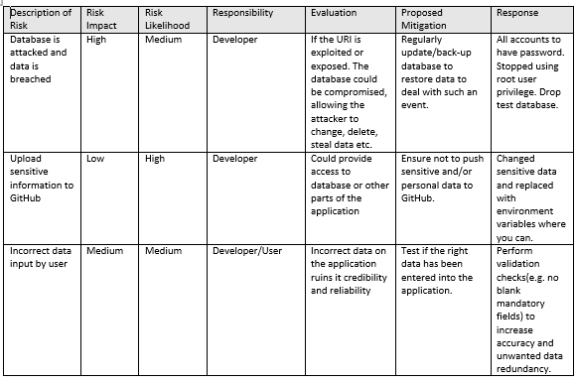
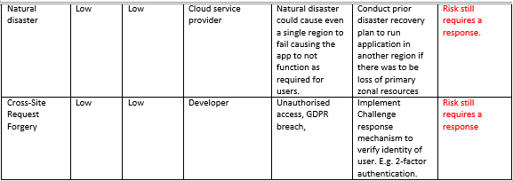
Risk MATRIX
Why?
Compensation
Fines
Legal cases
Increased insurance
Bad reputation
High staff turnover- Low morale

Slide 6
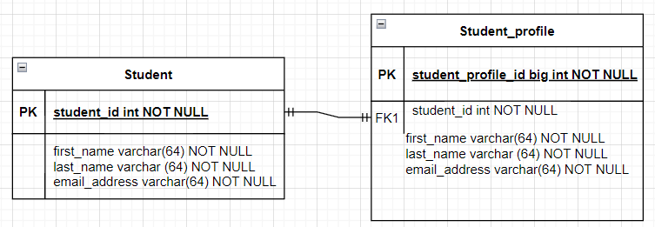
Diagrams

Slide 7
Sprint planning discussion
What?
This is the goal. Identify the backlog items that need to be done.
How?
Value and effort. Balance between value and effort.
(Specifics to follow on next slide)

Slide 8
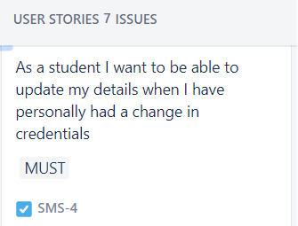
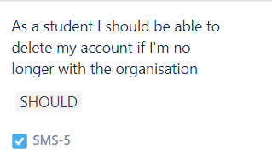
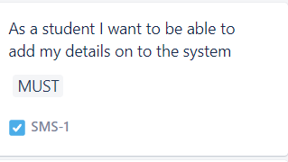
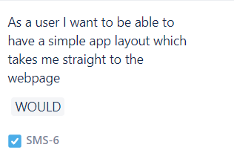
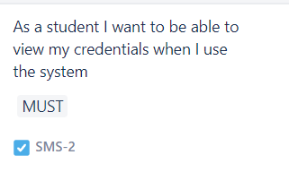
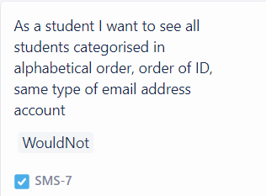
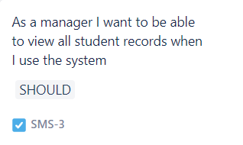
Use of Prioritisation
MoSCoW method

Slide 9
My journey
Obstacles
Uncertainty about Will not have user stories. Abandon entirely or include in next sprint
Technologies I have gained skills in that are relevant to the project:
Jira
Maven- Build Tool
Spring
Postman
Java
Eclipse
MySQL
HTML, CSS, JavaScript

Slide 10
Demonstration of project

Slide 11
Sprint review
As witnessed from the first sprint of app development, there is a lot of work to be done to determine future adaptations.
Despite adopting an iterative approach, the aim of having a functional application available to use after every sprint has failed.
The product backlog would need to be changed moving forward.
Problems encountered but that which doesn’t justify poor performance:
Laptop Bitlocker. Then sign in with pin not working.
Having to rewatch videos to understand key concepts.
Time management proved really difficult. Forced to work overtime to produce little work.
Main thing is I have learnt a lot is to start with the most difficult task first.

Slide 12
Sprint retrospective
Focus on continuous improvement in agile methodology.
Connect database to front-end
Ensure front end is more aesthetically pleasing for users.
Continue to learn new content if the opportunity is still there.
Further create user stories to make application even more suited to users.
Continue to build on the foundations set in each part of the project.
Implement testing that works.

Slide 13
Thank you for listening
Feel free to ask questions

